Slide 1





Smartbuy: A product order Management system
Course Title: Computer Fundamentals and Programming
Course No: EE 1222
Presented by:
Name: Ahnaf Tahmid
Roll:2203088
Name: Mehedi Hasan Jihan
Roll:2203089
Name: Sanjid Hasan
Roll:2203090
Department of Electrical And Electronic Engineering
Khulna University Of Engineering And Technology , Khulna

Slide 2



In this project these key aspects were attempted to be addressed
Enable
Efficient access
Simplify
Business
Maintain Order

Slide 3
Features of project:
Simple yet secure
Easy yet helpful
User friendly yet feature-rich
Minimalistic yet efficient
Effortless yet functional

Slide 4
Control over the business can be achieved through various aspects of the products.
price
Stocks
products
access
attainability

Slide 5
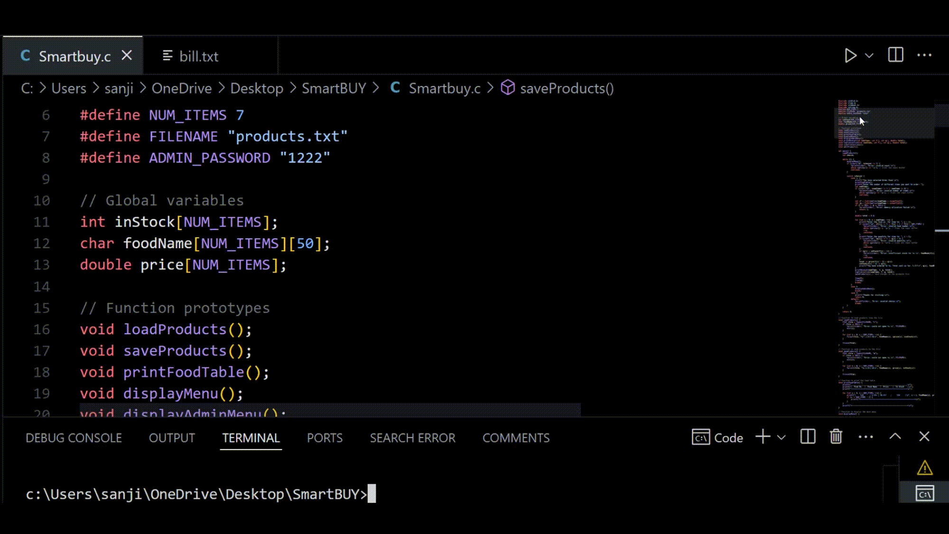
Let’s have a quick view of our code

Slide 6
A flow chart for the code-
A text file containing business information
Taking input from the user
Giving the user his desired output
Adjusting the information according to users usage
Rearranging the data according to users update

Slide 7
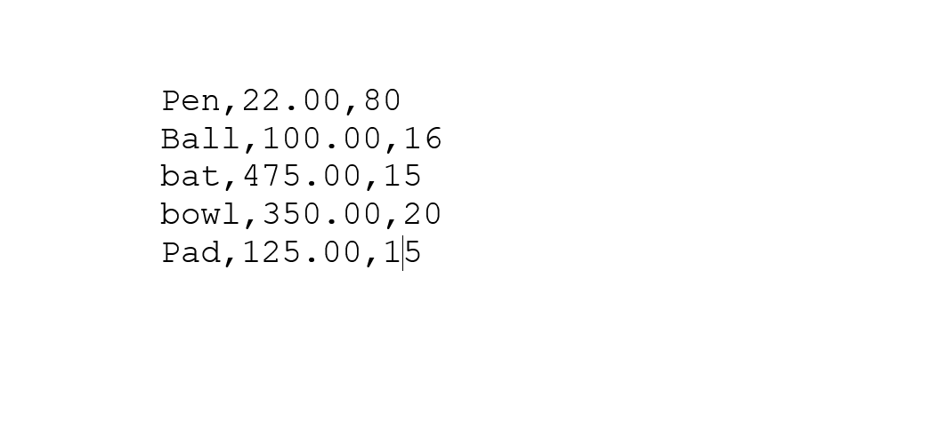
This text file contains Products' details, stocks, price data of a supposed business

Slide 8
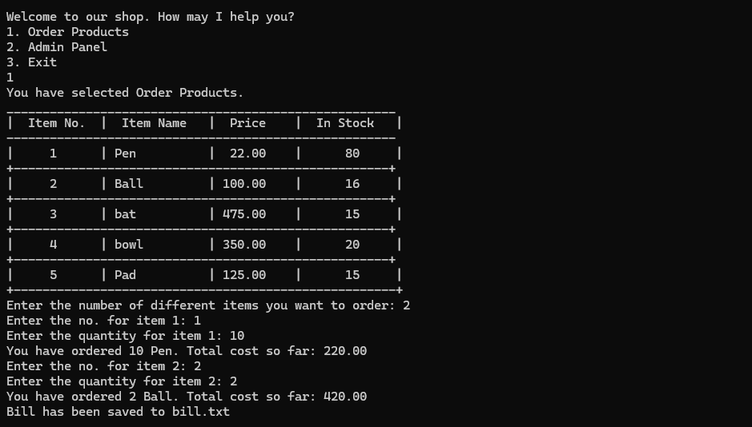
Let's run the code.

Slide 9
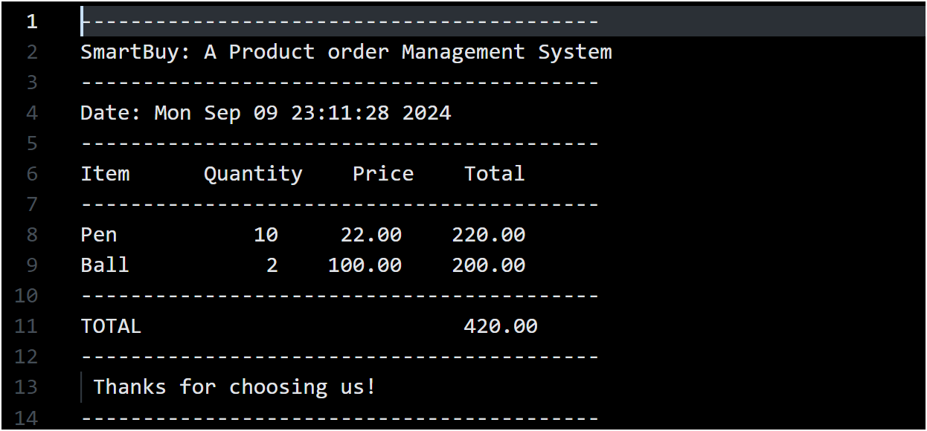
Data has been saved to bill.txt as a receipt

Slide 10
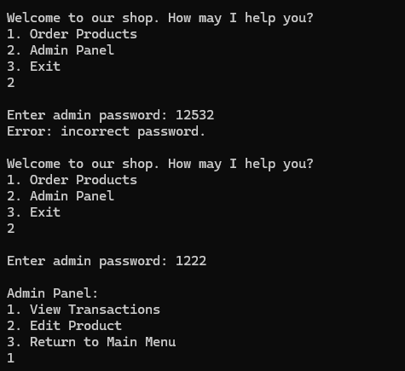
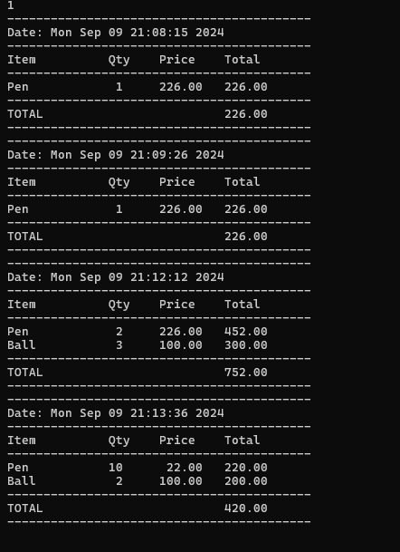
Viewing transaction history easily

Slide 11
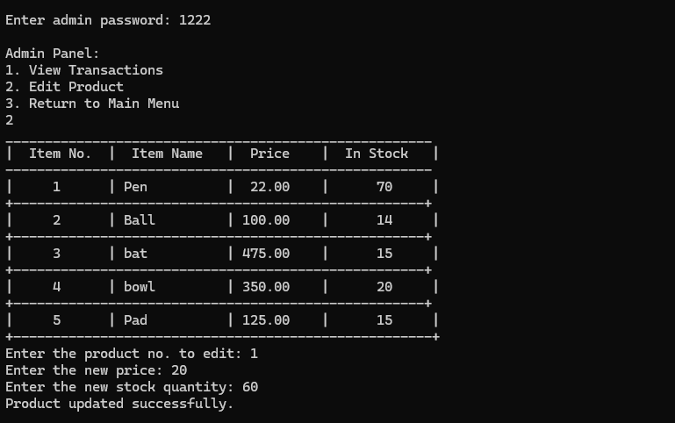
Easy data manipulation by users demand

Slide 12
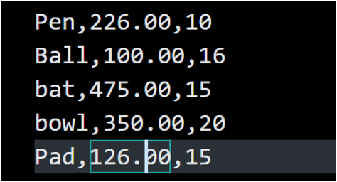
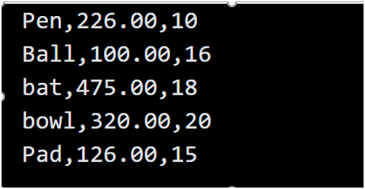
User can also manipulate data by making a little change in products.txt
Before:
After:

Slide 13
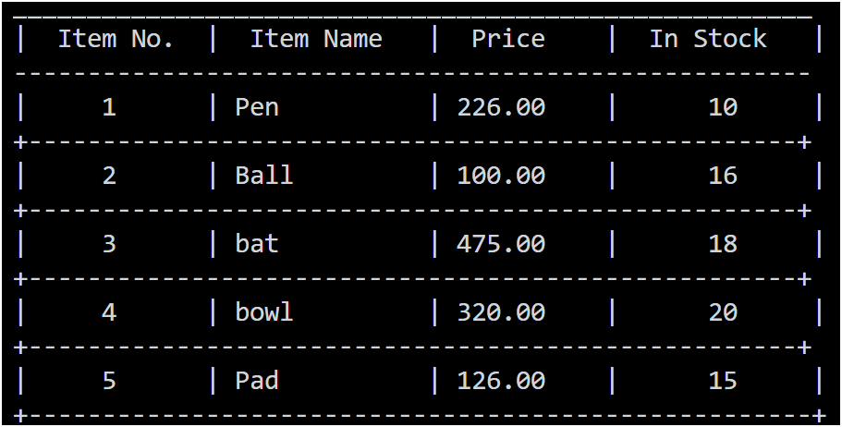
Thus the stock and price was easily updated

Slide 14
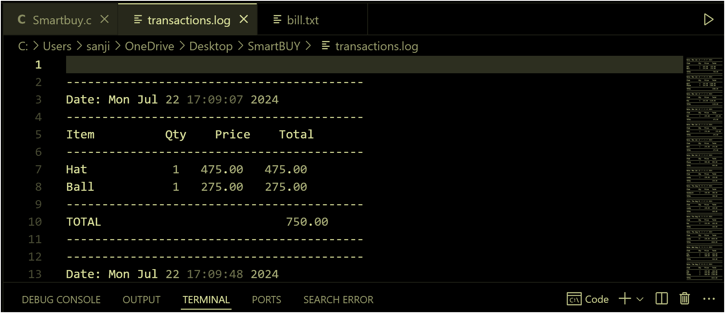
This code also saves a transaction.log Which can be viewed from in and outside of the code

Slide 15
In this project, using C programming language a code sufficient enough was produced to neutralize the problem in blooming businesses.
A business owner can-
A customer can-
Take order smoothly
Place order smoothly
Maintain stock easily
Be informed of his choice
Be informed of his business situation
Be informed of his expense

Slide 16
Field of application of project:
Any simple business
Any record keeping
Audit trail maintenance
Inventory tracking
Log maintenance
And so on……….

Slide 17


